Slide 1
VisPlayer, 3DShape, by OneCompany
World’s easiest cloud 3D Editor

Slide 2
General 3D design (CAD) Market
At the end of 2011, Jon Peddie Research (JPR) released its "2012 CAD Report," which estimated the number of active CAD users worldwide to be 19.3 million.
Of those 19.3 million global CAD seats, according to JPR, 27% are based in Asia; 34% in North America; and 37% in Europe, the Middle East, and Africa (EMEA). The BRIC countries (Brazil, Russia, India, and China) are growing most quickly.
Jon Peddie Research estimates the CAD software market to be an $8 billion market with 5.15M annual users. We expect the market to grow to $8.7 billion in 2017 at a CAGR of 4%.

Slide 3
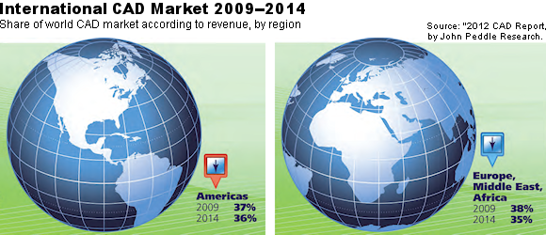


Slide 4
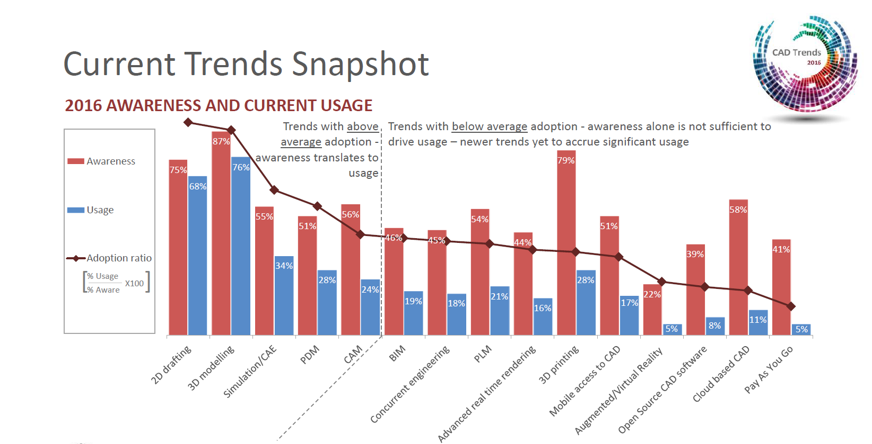
Industry Trends

Slide 5
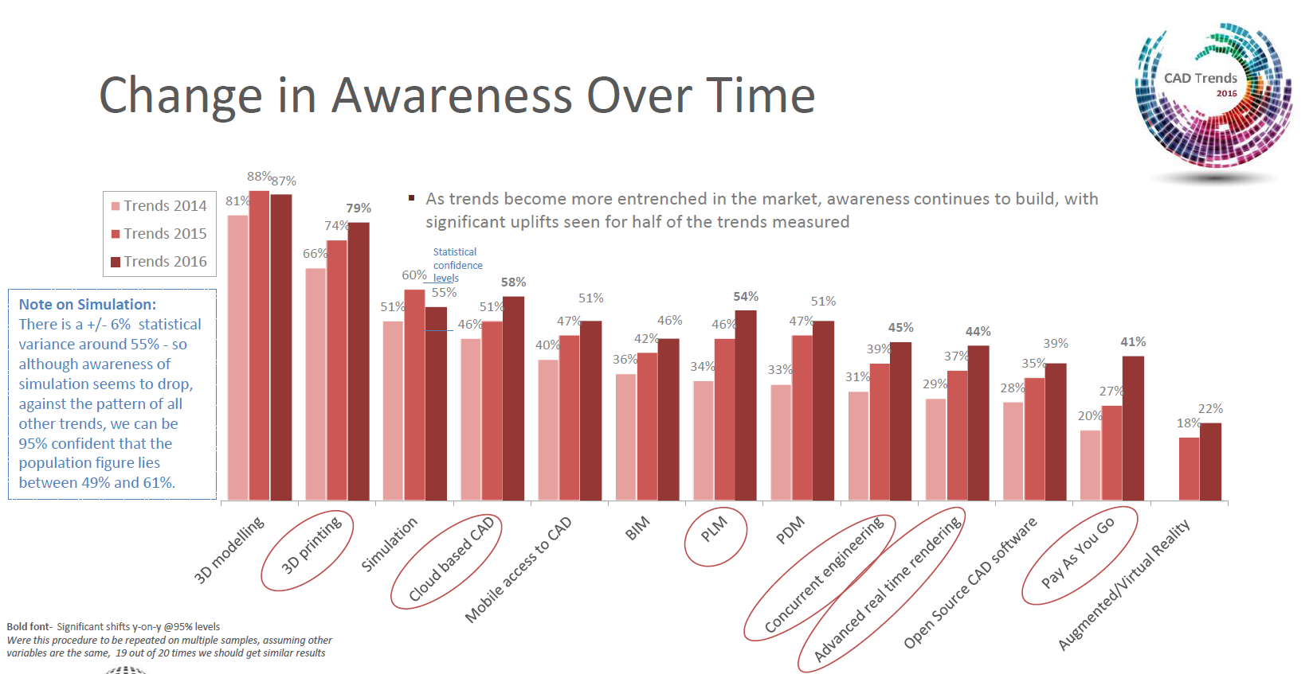
Industry Trends Continue

Slide 6
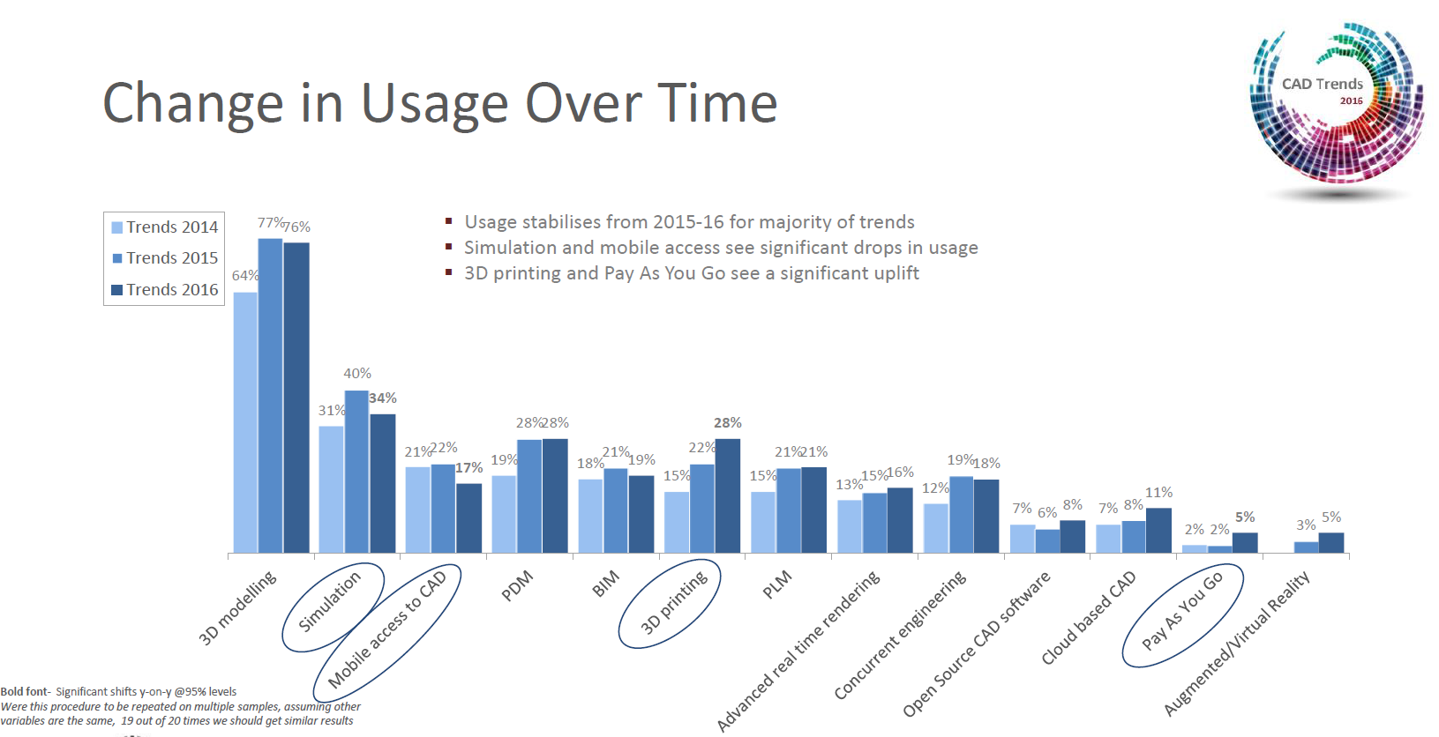
Industry Trends Continue

Slide 7
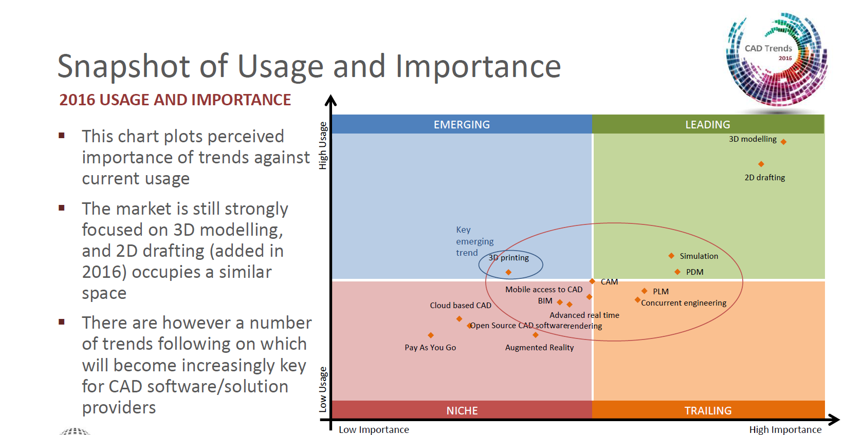
Industry Trends Continue

Slide 8
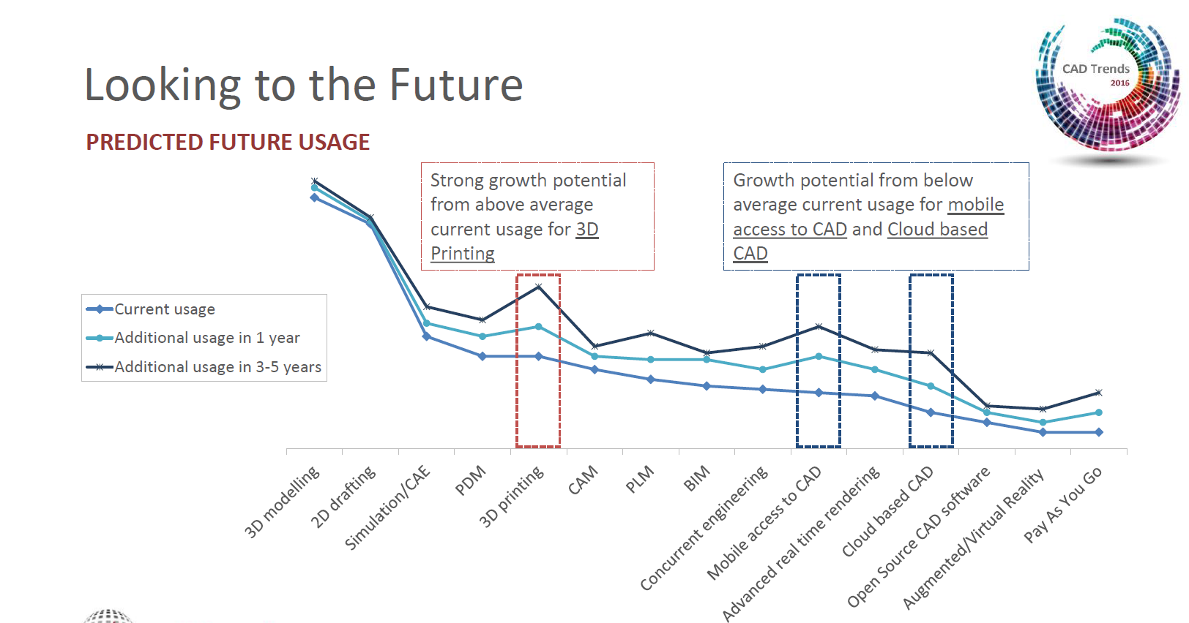
Industry Trends Continue

Slide 9
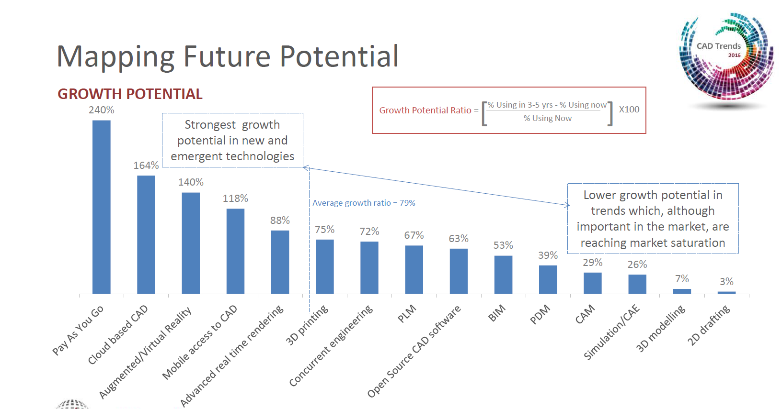
Industry Trends Continue

Slide 10
3D Printing Design Market
3D printing will eventually become a commodity
300,000 3D printer sold in 2016
3D printers sells project to increase high double digit percentage in next 5 - 10 years
Easy-to-use 3D design software tool is much needed
Most of 3D design software tools are targeting high-end users and enterprises that have high price tag and very difficult for general users to learn and use.
Other 3D image capture devices

Slide 11

3D Image Capture Devices
Largan Precision, one of the current suppliers for the iPhone's camera lens component, today confirmed that it will ship lenses for 3D sensing modules in the second half of 2017, suggesting inclusion in the next-generation "iPhone 8." The confirmation comes from Largan CEO Adam Lin

Slide 12

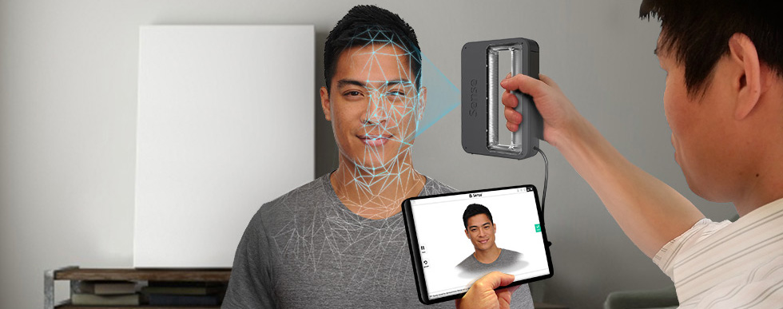
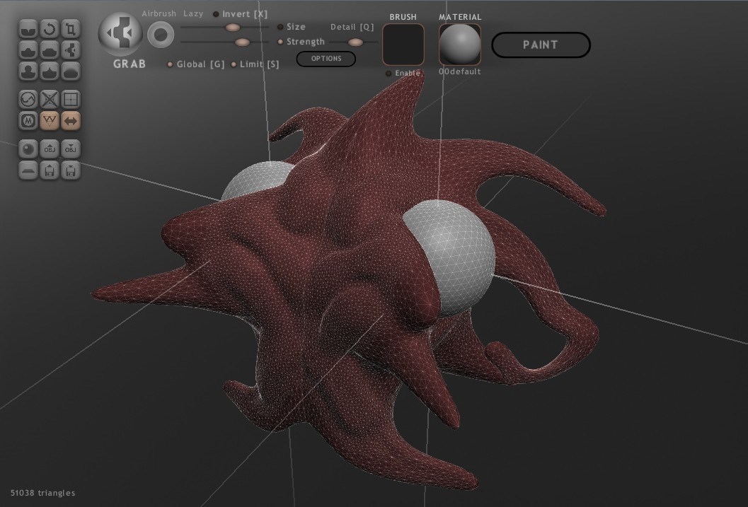

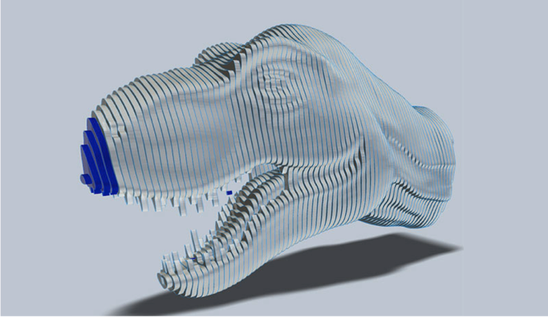
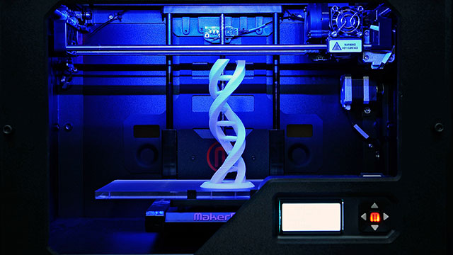
FROM 3D SCANNING TO 3D PRINTING
3D Scanning
3D Reconstruction
Mesh Repair
Mesh Editing
Mesh Validation
Modeling
Sculpturing
Preprocessing for Printing
3D Printing
Design for Manufacturing
G-Code Generation
Mesh Slicing

Slide 13
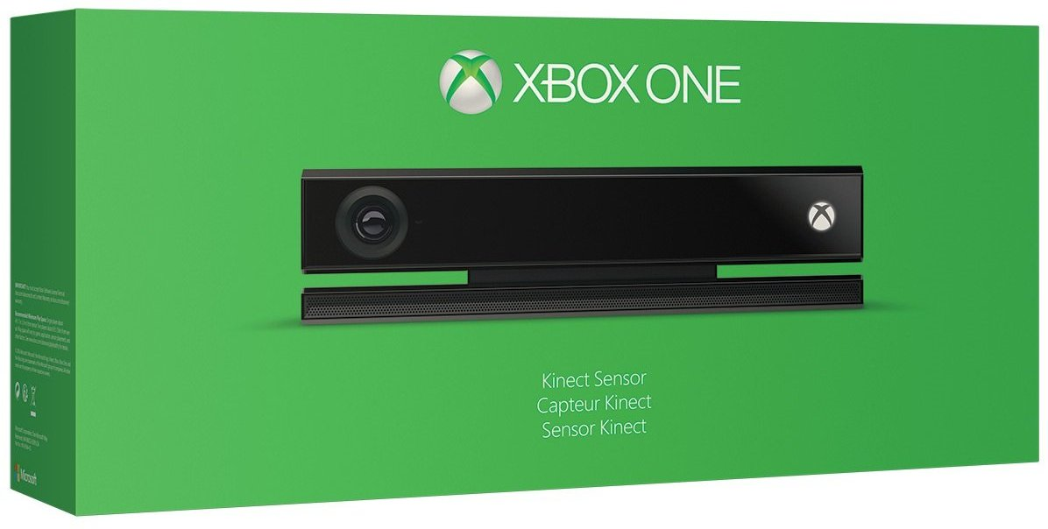
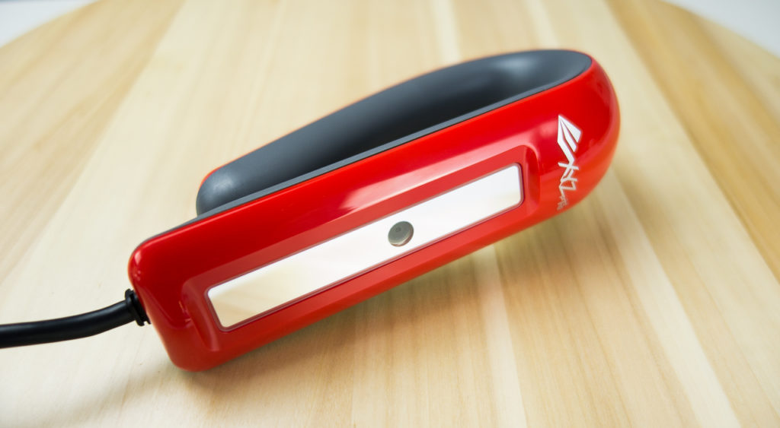
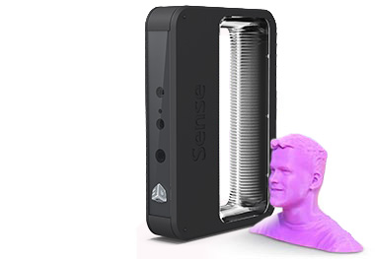
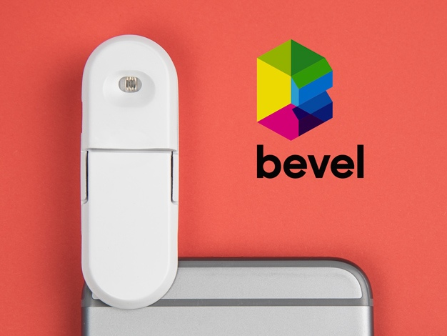
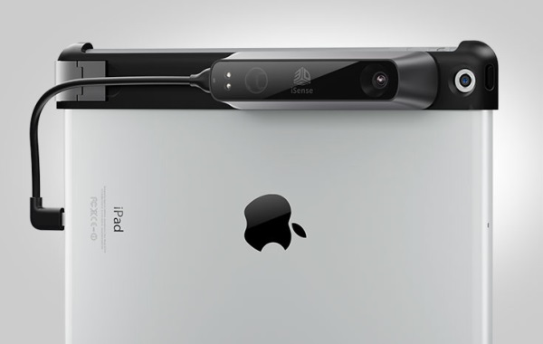
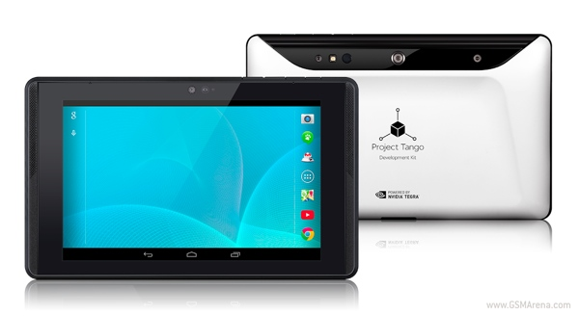
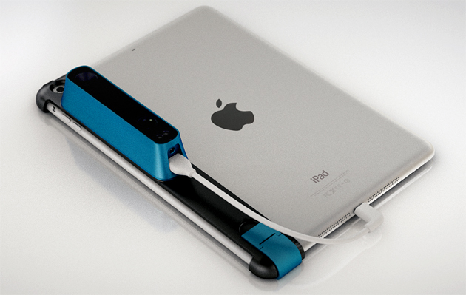
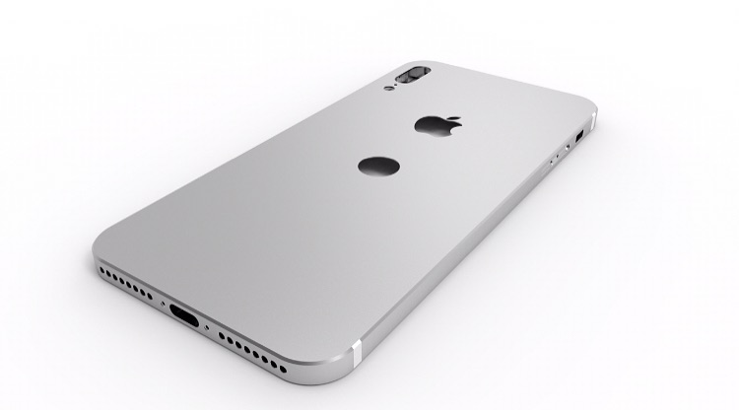
3D SCANNING BECOMES EASY
XBOX ONE
XYZ 3D Scanner
XYZ 3D Scanner
Sense
Bevel Scanner
Bevel Scanner
iSense
Project Tango
Project Tango
Strucutre Sensor
iPhone
iPhone

Slide 14
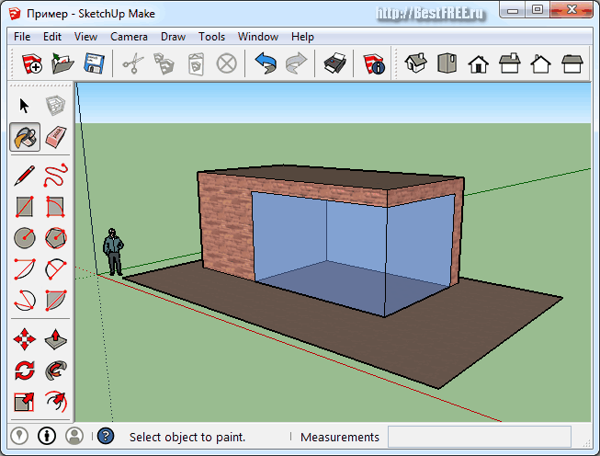
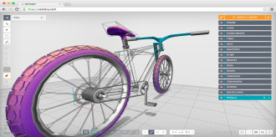
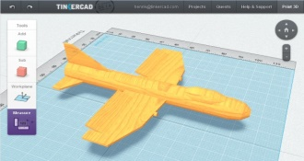
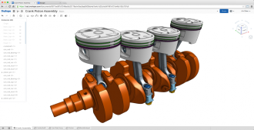
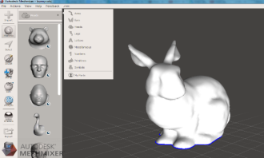
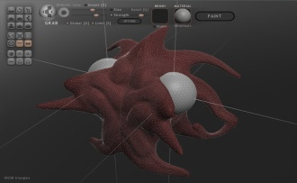
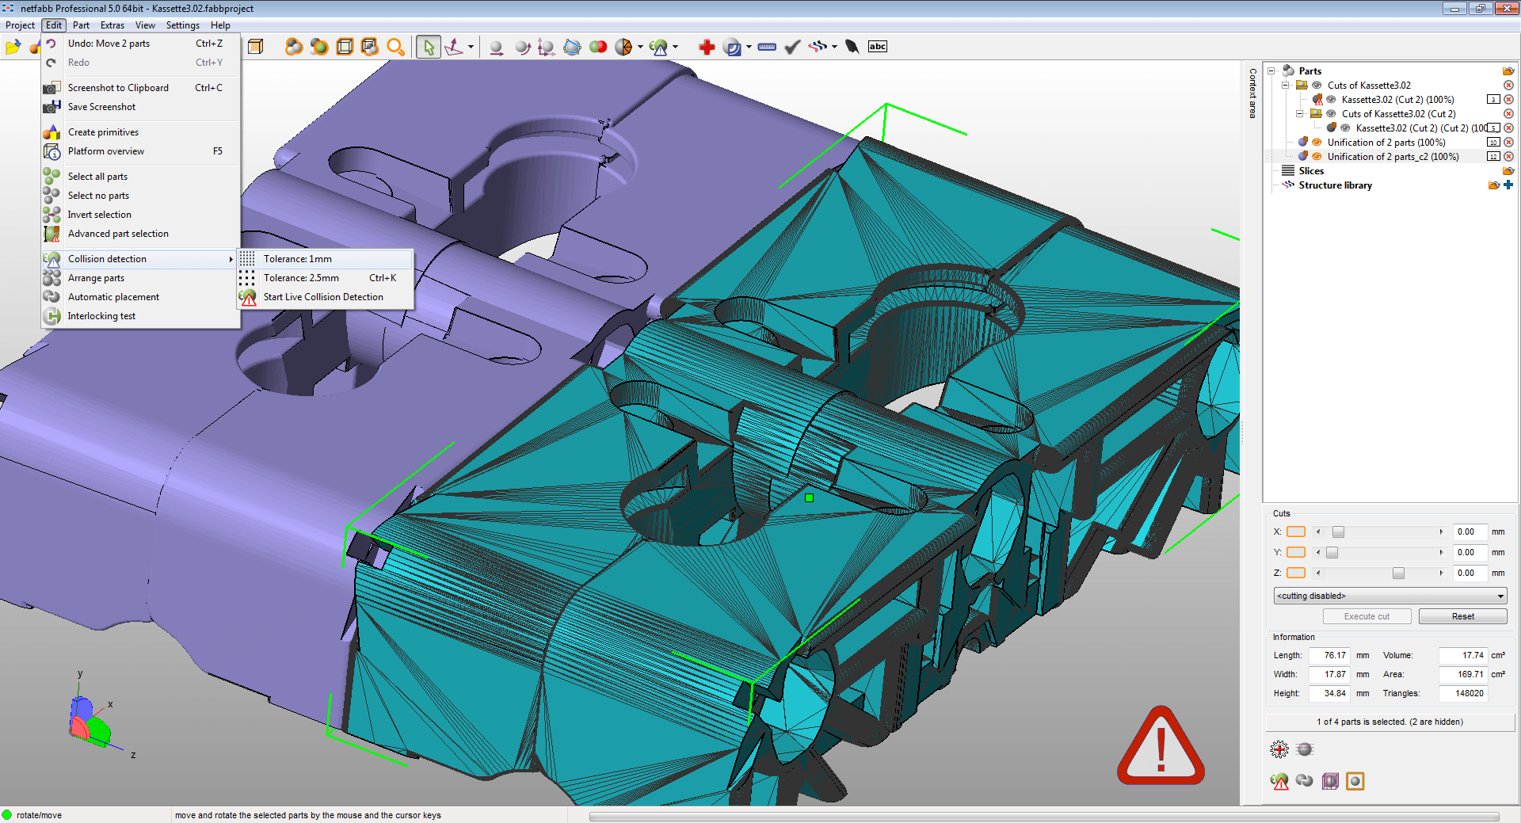
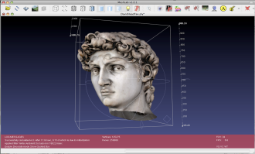
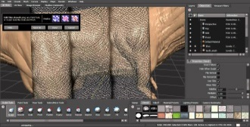
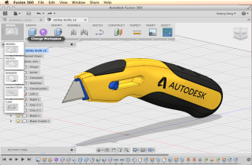
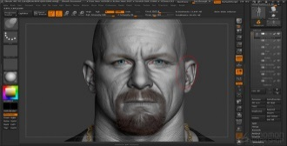
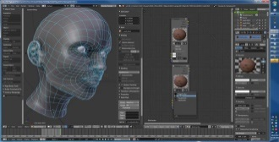
MODELING IS PAINFULL
Technology
MESH
SUBDIVISION
NURBS
Dong insert product pictures
BLANK
Usability

Slide 15

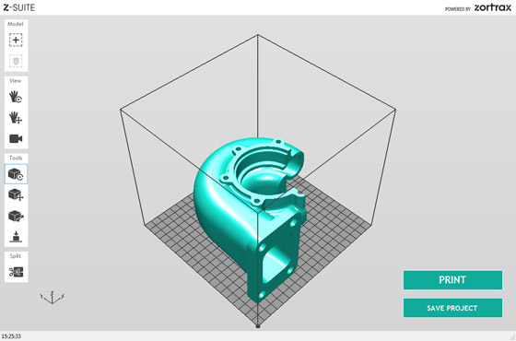
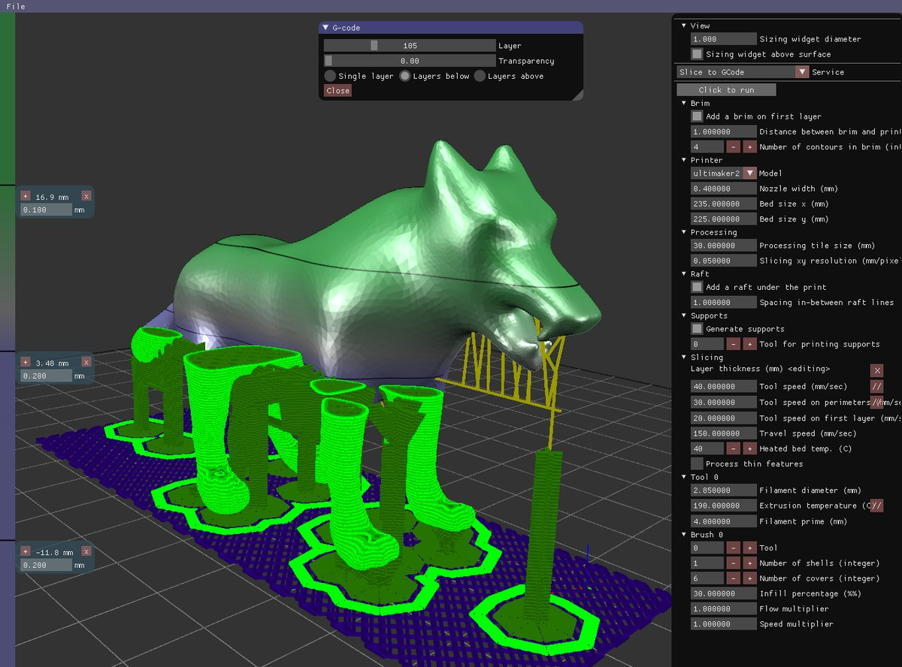
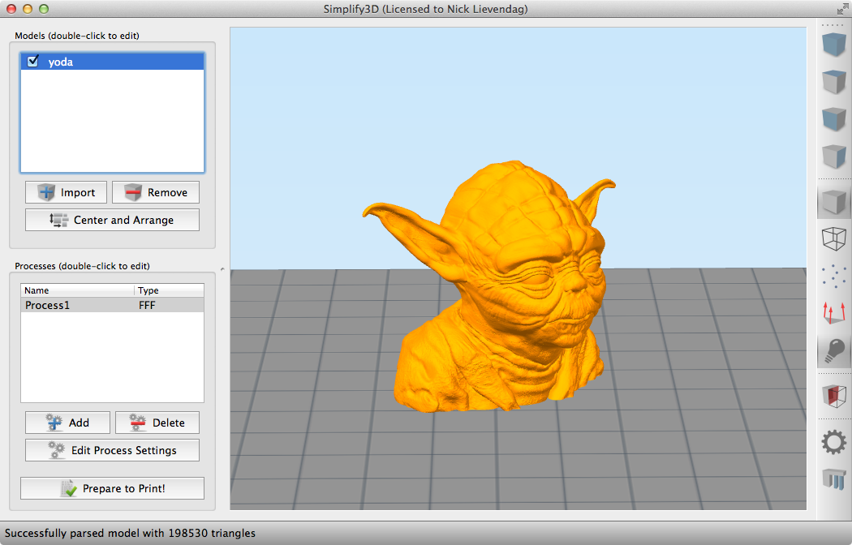
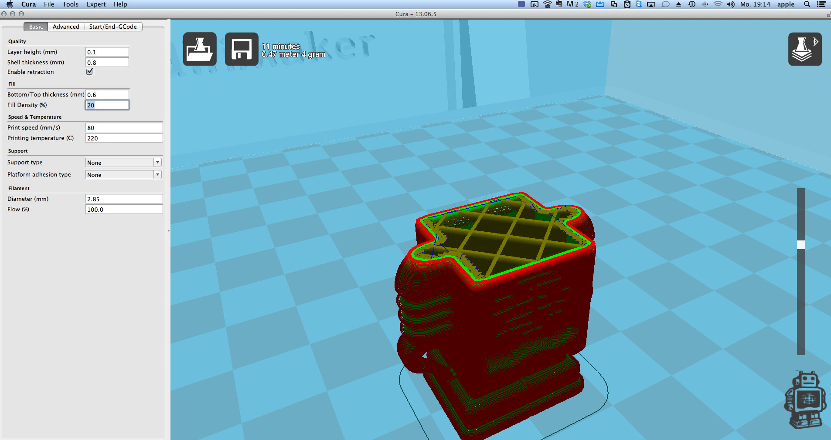
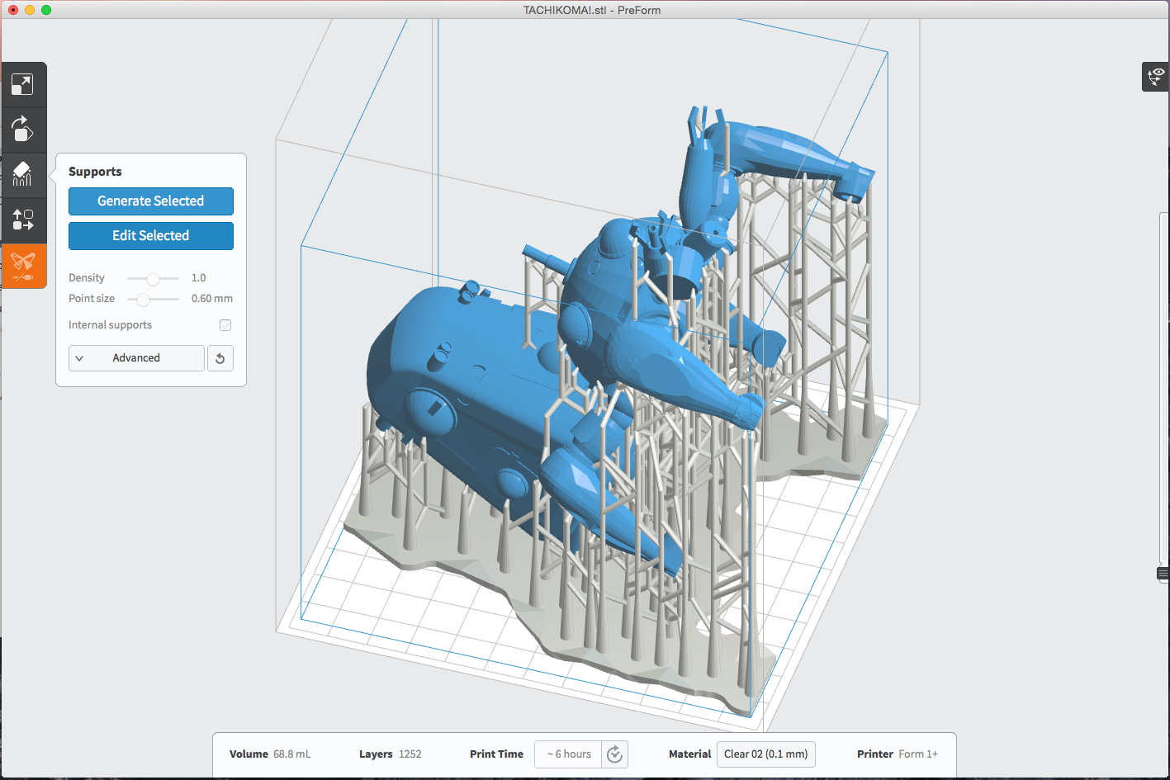
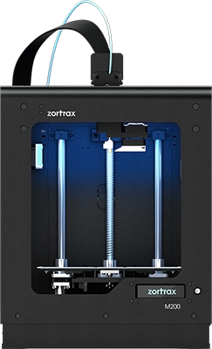
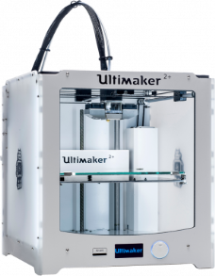
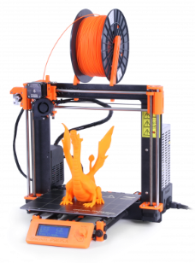
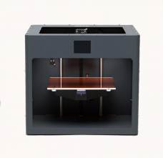
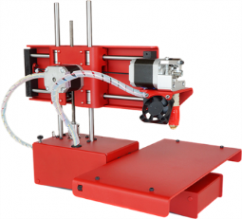
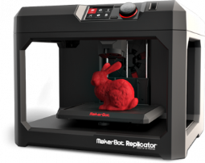
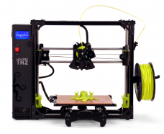
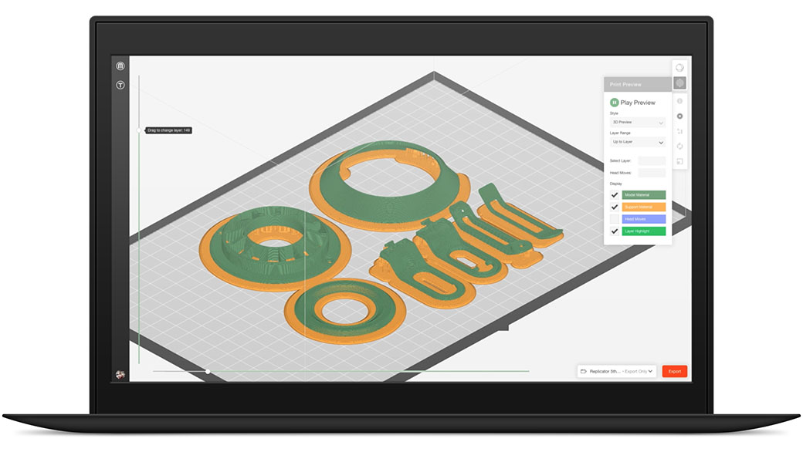
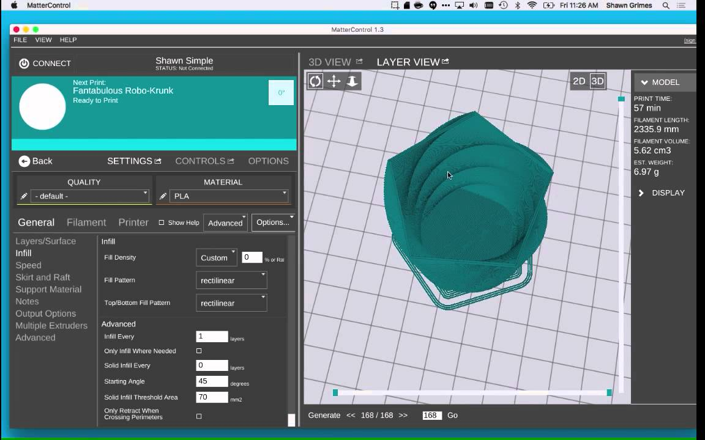
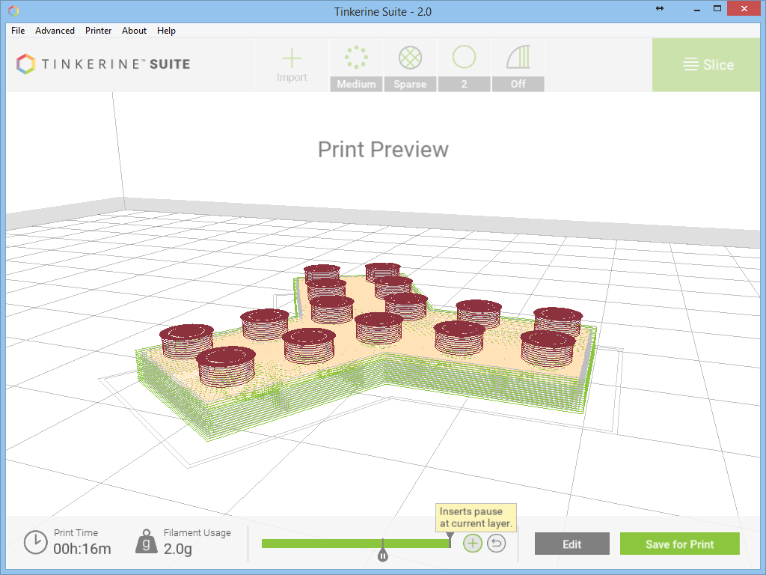
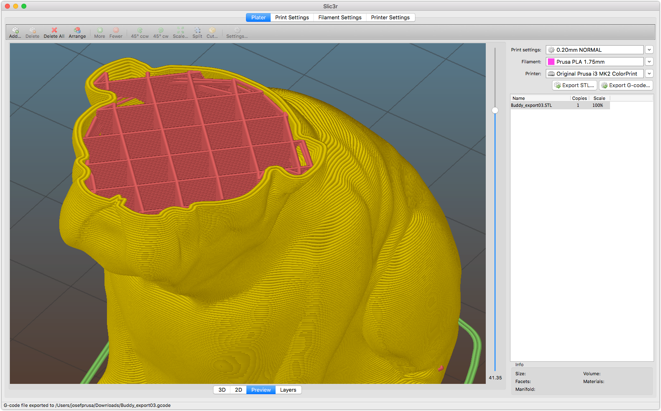
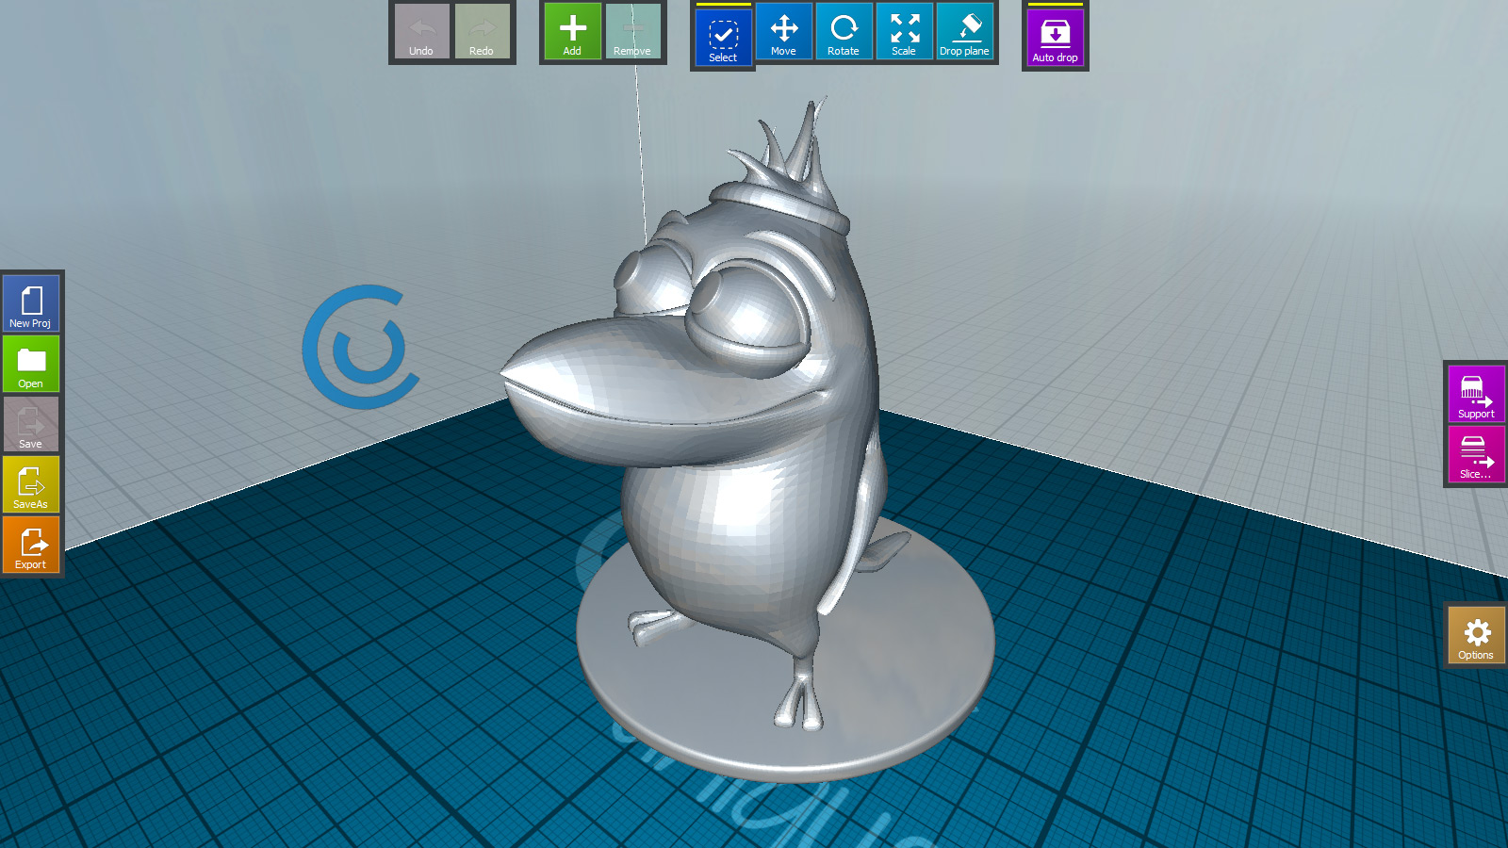
PREPROCESSING IS CHAOTIC
Each 3D printer manufacturing develops their own editing tool
No industry standard format
No knowledge base / lesson learned – Design for Manufacturing
...
...
...

Slide 16
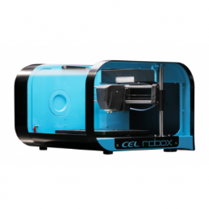
3D PRINTING
There are over 500 3D printer manufacturers in the world
Scattered software design tool
for 3D printing design
3D printer manufactures need to develop and support their own design tool
Small 3D printer manufactures pay for manual 3D model editing
Ultimaker Ultimaker 2+
CEL Robox
Original Prusa i3 MK2
Zortrax M200
CraftBot PLUS
Printrbot Simple Metal
LulzBot TAZ 6
Replicator 5th Gen

Slide 17
Current Challenges
3D printer can’t be accepted by daily household
Public acceptable modeling tools not available
Editing and post-processing tools are very focused in certain areas, no integrated solution
3D model search ability
High Cost
Traditional CAD system costs $10,000 - $30,000 per user + 20% - 30% annual maintenance fee
Usability of design tools
Deep learning curve
Transition training from one CAD system to another takes 4-8 weeks, costs $20,000 - $500,000 based on number of users
eLearning online account costs ~$1,000 annually
Mostly non cloud based
Based on 20 yrs + technology
Accessibility
Access any where from any device
Around the globe team design need
Light foot print (browser only)
Flexible Pricing
3D Data intelligence (Data AI)
3D model recognition – model searching
3D processing template/module – knowledge reuse

Slide 18
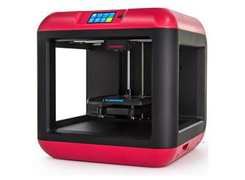
3D printing process
CAD data creation/import
CAD Design tool to modify 3D design file (STL File)
Scanning
Slicer to generate G code for 3D printer
Printing
Pre-processing for Printing

Slide 19
WHY WE NEED 3D SCANNING AND 3D PRINTING
3D Measurement
Interior Design
Interior Decoration
Customized Products
Old Parts Reproduction
One of a Kind Ornaments
One of a Kind Toys and Games
One of a Kind Medical Devices
Art Pieces
Food Production
Apparel and Fashion
Educational Models
Rapid Prototyping
…

Slide 20



WHAT WE DO
World easiest cloud 3D design tool with little or no training needed
Cloud Based
Easy to Use
Mesh Modeling
Cloud-Based 3D Design & Printing Toolbox
Subscription
3D processing templates
Cloud-Based 3D Model Repository
Personalized Items
Tools
Education
3D Data AI Engine
Toys

Slide 21
WHAT WE DO
World easiest 3D design tool with little or no training
Based on all new Mesh model methodology
Cloud based for easy access, minimum support requirements,
Subscription pricing model
Standard for 3D printing design tool
World largest 3D model database

Slide 22
Competitive Analysis
Software | Function | Geometry |  |  |  |  | Modeling |  |  |  | Manufacturing |  |  |  |  |  | Level | Price | System
 |  | Voxel | Mesh | Polygon | Subdivision | NURBS | Block | Laminate | Clay | Parametric | STL Viwer | STL Checker | STL Repair | STL Eidtor | Slicer | Hosting
123D Catch | Design |  | √ |  |  |  |  |  | √ |  |  |  |  |  |  |  | Beginner | Free | PC, Web, Mobile
123D Design | Design |  |  |  |  | √ |  |  |  | √ |  |  |  |  |  |  | Beginner | Free | PC, Web, Mobile
123D Make | Design |  | √ |  |  |  |  | √ |  |  |  |  |  |  |  |  | Beginner | Free | PC, Web, Mobile
123D Sculpt+ | Design |  | √ |  |  |  |  |  | √ |  |  |  |  |  |  |  | Beginner | Free | PC, Web, Mobile
3D View / Build | Design |  | √ |  |  |  |  |  | √ |  | √ |  |  |  |  |  | Beginner | Free | PC
3D-matic | Editinig |  | √ |  |  |  |  |  | √ |  | √ | √ | √ | √ | √ |  | Professional | Proprietary | PC
3DReshaper | Editinig |  | √ |  |  |  |  |  | √ |  | √ | √ | √ | √ |  |  | Professional | Proprietary | PC
3DTin | Design |  |  |  |  | √ |  |  |  | √ |  |  |  |  |  |  | Beginner | Free | Web
3D-Tool Free Viewer | Viewer |  | √ |  |  |  |  |  |  |  |  |  |  |  |  |  | Intermediate | € 60,000 | PC
Blender | Design |  |  |  | √ |  |  |  | √ | √ |  |  |  |  |  |  | Professional | Free | PC
ChronoSculpt | Design |  | √ |  |  |  |  |  | √ |  |  |  |  |  |  |  | Professional | $399 | PC
ClayTools | Design |  | √ |  |  |  |  |  | √ |  |  |  |  |  |  |  | Professional | Proprietary | PC
CraftWare | Printing |  |  |  |  |  |  |  |  |  | √ |  |  |  | √ | √ | Beginner | Free | PC
Cura | Printing |  |  |  |  |  |  |  |  |  | √ |  |  |  | √ | √ | Beginner | Free | PC
DesignX | Design |  | √ |  |  |  |  |  | √ |  |  |  |  |  |  |  | Professional | Proprietary | PC
Dreamcatcher | Design |  | √ |  |  |  |  |  |  |  |  |  |  |  |  |  | Beginner | Free | Web
Dynamo | Design |  |  |  |  | √ |  |  |  | √ |  |  |  |  |  |  | Professional | $300/y | PC
Form-Z Pro | Design |  | √ |  |  |  |  |  | √ |  |  |  |  |  |  |  | Professional | Proprietary | PC
FreeCAD | Design |  |  |  |  | √ |  |  |  | √ |  |  |  |  |  |  | Intermediate | Free | PC
Freeform Plus | Design |  | √ |  |  |  |  |  | √ |  |  |  |  |  |  |  | Professional | Proprietary | PC
Fusion 360 | Design |  | √ |  | √ | √ |  |  | √ | √ |  |  |  |  |  |  | Professional | Free, $300/y | PC
GrabCAD | Viewer |  | √ |  |  | √ |  |  |  |  |  |  |  |  |  |  | Beginner | Free | Web
Grasshopper | Design |  |  |  |  | √ |  |  |  | √ |  |  |  |  |  |  | Beginner | Free | PC
Inspire | Optimization |  | √ |  |  |  |  |  |  | √ |  |  |  |  |  |  | Professional | Proprietary | PC
Meshfix | Editinig |  | √ |  |  |  |  |  | √ |  |  |  | √ |  |  |  | Intermediate | Free | DOS
MeshLab | Editinig |  | √ |  |  |  |  |  | √ |  | √ | √ | √ | √ |  |  | Professional | Free | PC
Meshmixer | Editinig |  | √ |  |  |  |  |  | √ |  | √ | √ | √ | √ |  |  | Professional | Free | PC

Slide 23
Competitive Analysis
Highlights of industry movement:
Autodesk acquired 26
CAD design companies in the last 6 years
Lagoa raised 3 rounds in total of $8.4 M, was acquired by Autodesk on Nov 20, 2014 for $60M (Apr 2013 $1.6 M, Dec 2013 $5.3M, Feb 2014 $1.6M)
TinkerCAD raised $1 M in round 1 in Nov 2011, was acquired by Autodesk on May 5, 2013 for unknown amount
Software | Function | Geometry |  |  |  |  | Modeling |  |  |  | Manufacturing |  |  |  |  |  | Level | Price | System
 |  | Voxel | Mesh | Polygon | Subdivision | NURBS | Block | Laminate | Clay | Parametric | STL Viwer | STL Checker | STL Repair | STL Eidtor | Slicer | Hosting
Netfabb | Editinig |  | √ |  |  |  |  |  | √ |  | √ | √ | √ | √ | √ |  | Intermediate | € 1,500 | PC
OctoPrint | Printing |  |  |  |  |  |  |  |  |  |  |  |  |  |  | √ | Professional | Free | Web
OnShape |  |  |  |  |  | √ |  |  |  | √ |  |  |  |  |  |  | Professional | Free | Web
P3D.in | Viewer |  | √ |  |  |  |  |  |  |  |  |  |  |  |  |  | Beginner | Free | Web
ParaView | Viewer |  | √ |  |  |  |  |  |  |  |  |  |  |  |  |  | Professional | Free | PC, Web
PCL | Library |  | √ |  |  |  |  |  |  |  |  |  |  |  |  |  | Professional | Free, $300/y | PC
Recap |  |  | √ |  |  |  |  |  |  |  |  |  |  |  |  |  | Beginner | Free | Web
Remake | Editinig |  | √ |  |  |  |  |  | √ |  | √ | √ | √ | √ |  |  | Professional | Free, $300/y | PC
Repetier | Printing |  |  |  |  |  |  |  |  |  | √ |  |  |  | √ | √ | Intermediate | Free | PC, Web
Sculptris | Design |  |  |  | √ |  |  |  | √ |  |  |  |  |  |  |  | Beginner | Free | PC
Shapeshifter | Design |  | √ |  |  |  |  |  |  | √ |  |  |  |  |  |  | Beginner | Free | Web
Simplify3D | Printing |  |  |  |  |  |  |  |  |  | √ | √ | √ |  | √ | √ | Professional | $149 | PC
SketchFab | Viewer |  | √ |  |  |  |  |  |  |  |  |  |  |  |  |  | Beginner | Free | Web
SketchUp | Design |  |  | √ |  |  |  |  |  | √ |  |  |  |  |  |  | Intermediate | Free | PC
Slic3r | Printing |  |  |  |  |  |  |  |  |  | √ | √ | √ |  | √ |  | Professional | Free | PC
TinkerCAD | Design |  |  |  |  | √ |  |  |  | √ |  |  |  |  |  |  | Beginner | Free | Web
Vectary | Design |  |  |  | √ |  |  |  |  | √ |  |  |  |  |  |  | Intermediate | Free | Web
Visit | Viewer |  | √ |  |  |  |  |  |  |  |  |  |  |  |  |  | Professional | Free | PC
VTK | Library |  | √ |  |  |  |  |  |  |  |  |  |  |  |  |  | Professional | Free, $300/y | PC
VXmodel | Editinig |  | √ |  |  |  |  |  | √ |  | √ | √ | √ | √ |  |  | Professional | Proprietary | PC
Within | Optimization |  | √ |  |  |  |  |  |  | √ |  |  |  |  |  |  | Professional | Proprietary | PC

Slide 24
Competition Evaluation
Add fusion360/cura/tinker
Number of users and evaluation

Slide 25
Company/business Description
US based software company focus on cloud based 3D design editor for general public to use to fulfill general 3D printing needs.
Utilize internet subscription sales model, big data, and vertical integration to achieve global recognition.

Slide 26
3D printing process
CAD data creation/import
CAD Design tool to modify 3D design file (STL File)
Mesh Editing and Redesign
AI Model Engine
Scanning
Model Database
Slicer to generate G code for 3D printer
Printing
Pre-processing for Printing

Slide 27
Organization/operations & Management plan
Charles Wang – CEO
Zhao Dong – CTO
Maureen Huber – CFO

Slide 28
Charles Profile

Slide 29
Dong Profile

Slide 30
Maureen Huber

Slide 31
Roadmap and timeline
70 | 95 | 25
115 | 135 | 50
2017 & 2018 Phase 1
2019 Phase 2
Future
150 | 165 | 30
First Go-Live
XXX
Product development
Continue product version 2.0 development
Continue PD
Alpha release
Beta release
XXX
Design team expansion
Language and region expansion
XXX
XXX
Marketing for Go-Live
Corporate with educational institutions
XXX
XXX
Corporate with 3D printer manufacturers
XXX
XXX
3D model database
XXX
3D model AI Engine
XXX
XXX
Goal is to have 20,000 user by end of 2019
XXX

Slide 32
User Projection

Slide 33
Functionalities in each phase
Go Live version 1.0 (end of 2018)
3D Framework
3D Model Repository
3D Reconstruction
3D Modifiers
Version 2.0 (end of 2019)
Visual Computing (3D processing template)
AI Engine

Slide 34
Go To Market Strategy
Sales Model
Release 1.0
Subscription pricing model
Basic software is free to use
Pro version $19.99 / month
Pro Plus version $49.99 / month
Partner program with 3D printer manufacturers / contractors
Silver: $200 per user for 12 months < 500 users annually
Gold: $180 per user for 12 months between 500 and 1000 users annually
Platinum: $150 per user for 12 months > 1000 users annually
Release 2.0
3D processing template packages
3D models
Referral program: contractor for printing (10%)

Slide 35
Financial Projections
User projection
Goal is to have 20,000 user by end of 2019
E.g. $19.99 / month X 2,000 users (10% of all users) = $40,000 / month
Annual user target:
2020: 50,000 users
2021: 100,000 users
Partner program with 3D printer manufacturers / contractors
E.g. biggest 3D printer manufacturer sells 80,000 3D printers in 2016
Target 3 printer manufactures/contractors for 5,000 users in 2019
Estimate:
Charles insert number

Slide 36
Financial Plan for Release 1.0
Items | Sub-Items |  | Units | Unit Price | Expenses
Rental | Office |  | 12 | $5,000 | $60,000
Assets | Workstation |  | 6 | $5,000 | $30,000
Salaries | Development | Full Stack Developer | 1 | $90,000 | $90,000
 |  | Geometry Algorithm Developer | 1 | $100,000 | $100,000
 |  | Product Developer | 1 | $80,000 | $80,000
 |  | Document Writer (second half of the year) | 1 | $50,000 | $50,000
 | Marketing | Marketing material | 1 | $60,000 | $60,000
Other expense | Cloud Rental | 9 month after Alfa release | 9 | $1000 | $9,000
 | Domain rental | 12 month | 12 | $50 | $600
 | travel | every month for marketing/meeting travel | 12 | $1000 | $12,000
 | Backoffice | payroll | 12 | $1000 | $12,000
 | Others
Release 1 Financial Needs |  |  |  |  | ~$500,000

Slide 37
Funding Request
Asking $500,000 USD for 10% of the company

